Slide 1
Time series in Python
Abdullah Sharaf 2025

Slide 2
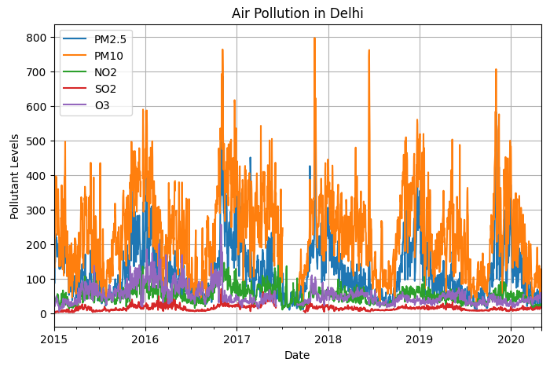
Air pollution in Delhi, India
Methodology
Classical Time Series
ARIMA / SARIMA
Figure 4: Indian air pollution by the author

Slide 3
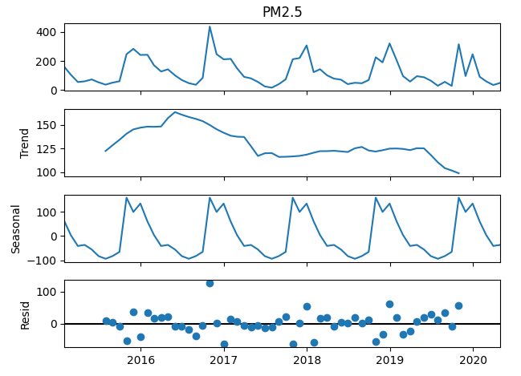
Seasonal Decomposition
Figure 7: PM2.5 Seasonal Decomposition by the author
Figure 5: PM2.5 Seasonal Decomposition by the author

Slide 4
Dickey-Fuller test results:
Original Series Result:
(0.3900829213624242, 0.9117414531540184, 11, 52,
{'1%': -3.562878534649522, '5%': -2.918973284023669, '10%': -2.597393446745562},
590.7464791622938)
After First Differencing Result:
(-8.30710421070434, 3.87707654e-13, 10, 52,
{'1%': -3.562878534649522, '5%': -2.918973284023669, '10%’: 2.597393446745562},
576.542858556311) 6524172
After Both Differencing Result:
(-7.272365742388234, 1.5762296347150443e-10, 2, 48,
{'1%': -3.5745892596209488, '5%': -2.9239543084490744, '10%': -2.6000391840277777},
435.0999904759374)

Slide 5
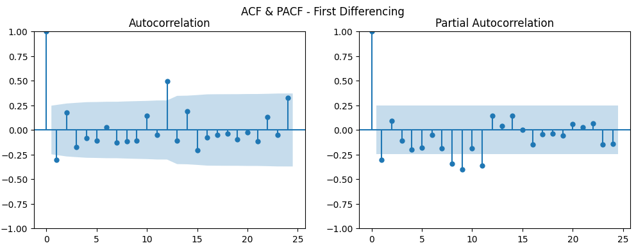
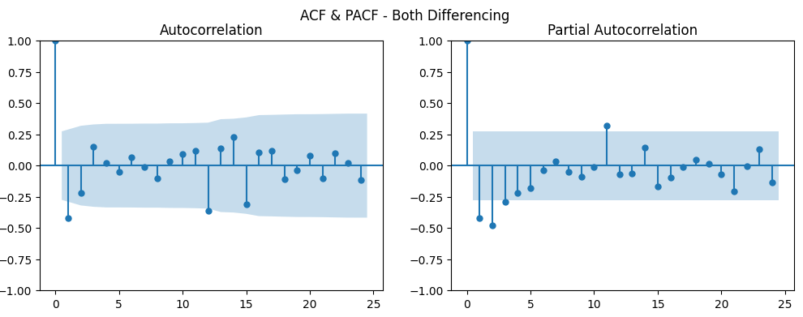
ACF-PACF
SARIMA(0,1,1)(0,1,1,12)
Figure 7: PM2.5 ACF-PACF by the author
Notes:
First Image (after first differencing only)
ACF:
Big negative spike at lag 1 → strong sign of an MA(1) term.
Positive spike around lag 12 → seasonal effect still present.
PACF:
Negative spike at lag 1, then smaller negative spikes at a few later lags.
This behaviour is also consistent with an MA(1) structure.
👉 Interpretation:
Data is differenced once (d=1), but seasonality is not yet handled.
Likely candidate: ARIMA(0,1,1) plus a seasonal term (to capture lag 12).

Slide 6
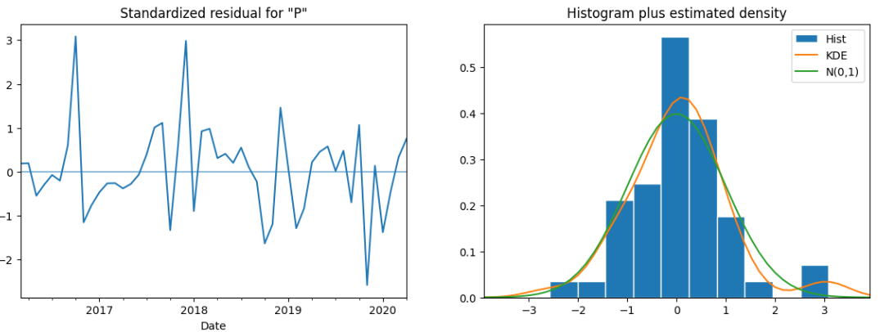
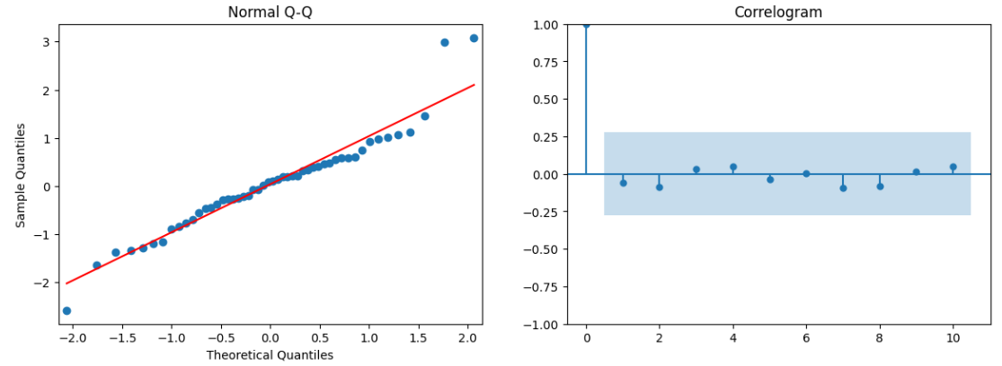
SARIMA Diagnostics
SARIMA(0,1,2)(0,1,2,12)
Figure 8. SARIMA diagnostic by the author

Slide 7
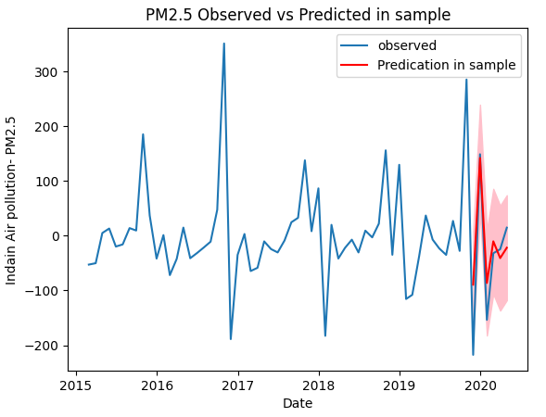
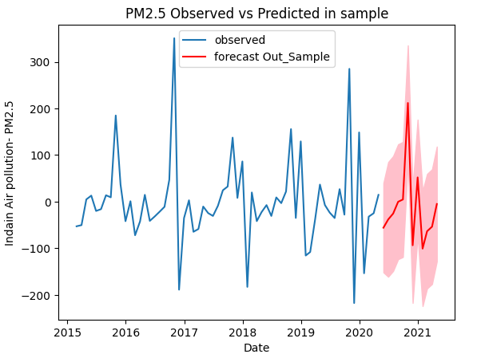
Predict In Sample
Future Forecast
Figure 8. SARIMA Prediction by the author

Slide 8
The End

